Slide 1
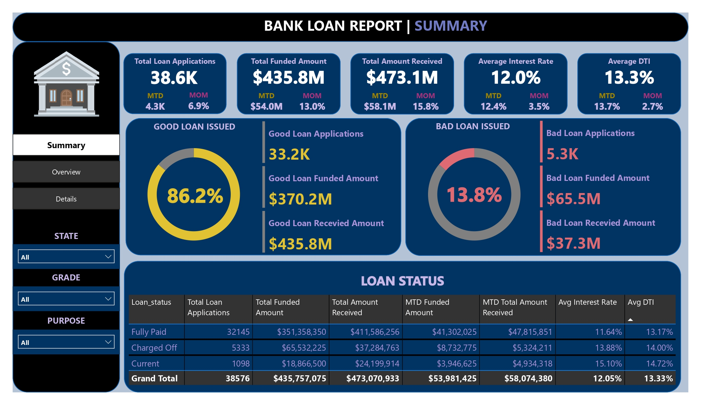

Slide 2
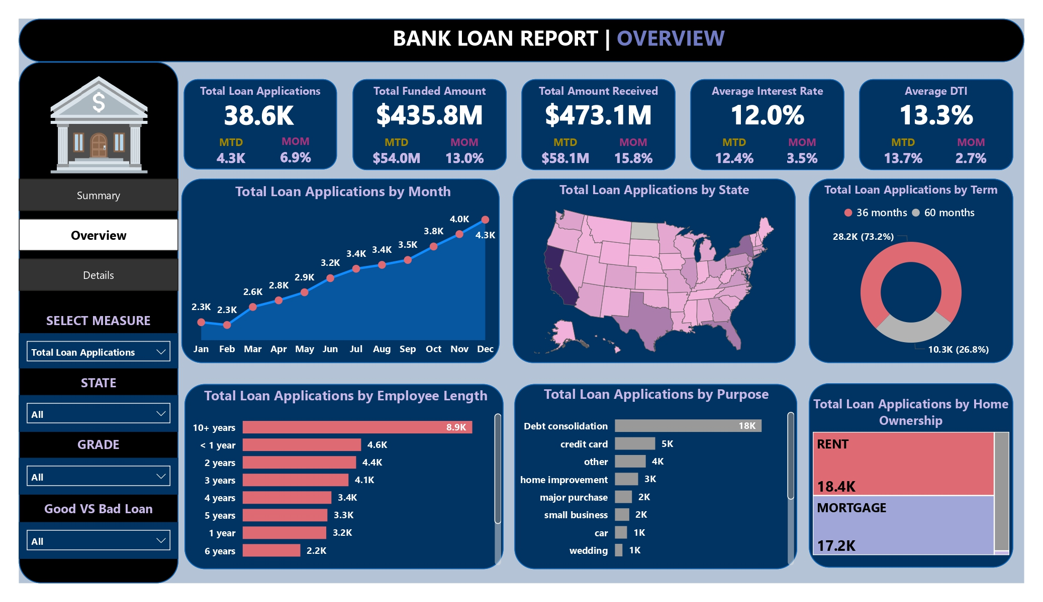

Slide 3
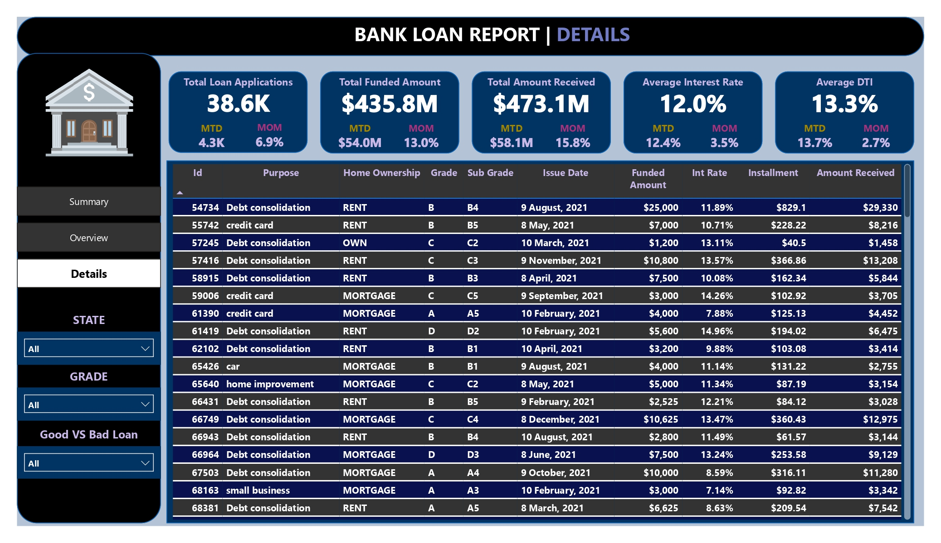

Slide 4
PROBLEM STATEMENT
DASHBOARD 1 : SUMMARY
Key Performance Indicators (KPIs) Requirements:
Total Loan Applications: We need to calculate the total number of loan applications received during a specified period. Additionally, it is essential to monitor the Month-to-Date (MTD) Loan Applications and track changes Month-over-Month (MoM).
Total Funded Amount: Understanding the total amount of funds disbursed as loans is crucial. We also want to keep an eye on the MTD Total Funded Amount and analyse the Month-over-Month (MoM) changes in this metric.
Total Amount Received: Tracking the total amount received from borrowers is essential for assessing the bank's cash flow and loan repayment. We should analyse the Month-to-Date (MTD) Total Amount Received and observe the Month-over-Month (MoM) changes.
Average Interest Rate: Calculating the average interest rate across all loans, MTD, and monitoring the Month-over-Month (MoM) variations in interest rates will provide insights into our lending portfolio's overall cost.
Average Debt-to-Income Ratio (DTI): Evaluating the average DTI for our borrowers helps us gauge their financial health. We need to compute the average DTI for all loans, MTD, and track Month-over-Month (MoM) fluctuations

Slide 5
PROBLEM STATEMENT
DASHBOARD 1 : SUMMARY
Good Loan v Bad Loan KPI’s
Good Loan:
Good Loan Application Percentage
Good Loan Applications
Good Loan Funded Amount
Good Loan Total Received Amount
Good Loan v Bad Loan KPI’s
Good Loan:
Good Loan Application Percentage
Good Loan Applications
Good Loan Funded Amount
Good Loan Total Received Amount
Loan Status Grid View
In order to gain a comprehensive overview of our lending operations and monitor the performance of loans, we aim to create a grid view report categorized by 'Loan Status.’ By providing insights into metrics such as 'Total Loan Applications,' 'Total Funded Amount,' 'Total Amount Received,' 'Month-to-Date (MTD) Funded Amount,' 'MTD Amount Received,' 'Average Interest Rate,' and 'Average Debt-to-Income Ratio (DTI),' this grid view will empower us to make data-driven decisions and assess the health of our loan portfolio.

Slide 6
PROBLEM STATEMENT
DASHBOARD 2 : OVERVIEW
CHARTS
Monthly Trends by Issue Date (Line Chart): To identify seasonality and long-term trends in lending activities
Regional Analysis by State (Filled Map): To identify regions with significant lending activity and assess regional disparities
Loan Term Analysis (Donut Chart): To allow the client to understand the distribution of loans across various term lengths.
Employee Length Analysis (Bar Chart): How lending metrics are distributed among borrowers with different employment lengths, helping us assess the impact of employment history on loan applications.
Loan Purpose Breakdown (Bar Chart): Will provide a visual breakdown of loan metrics based on the stated purposes of loans, aiding in the understanding of the primary reasons borrowers seek financing.
Home Ownership Analysis (Tree Map): For a hierarchical view of how home ownership impacts loan applications and disbursements.
Metrics to be shown: 'Total Loan Applications,' 'Total Funded Amount,' and 'Total Amount Received'

Slide 7
PROBLEM STATEMENT
DASHBOARD 3 : DETAILS
GRID
Need for a comprehensive 'Details Dashboard' that provides a consolidated view of all the essential information within our loan data. This Details Dashboard aims to offer a holistic snapshot of key loan-related metrics and data points, enabling users to access critical information efficiently.
Objective:
The primary objective of the Details Dashboard is to provide a comprehensive and user-friendly interface for accessing vital loan data. It will serve as a one-stop solution for users seeking detailed insights into our loan portfolio, borrower profiles, and loan performance.

